Slide 1
CONTENTS
INTRODUCTION
REQUIREMENTS
SYSTEM DESIGN
IMPLEMENTATION
TESTING
OUTPUT
ADVANTAGES
CONCLUSION

Slide 2
INTRODUCTION
Depression as a disorder has always been a focus of attention of researchers in India. Over the last 50-60 years, large number of studies has been published from India addressing various aspects of this commonly prevalent disorder.
Here, we review data on various aspects of depression, originating from India.
Depression is also often accompanied by anxiety. Research indicates that not only do the two conditions co-occur but that they overlap in vulnerability patterns.
Depression is highly treatable. The condition is often cyclical, and early treatment may prevent or forestall recurrent episodes. Chrome browser is developed in a way where a person can surf through the internet in order to look for photos, videos, music, web series and many more websites reflecting their moods, feelings and sentiments. This creates an opportunity to analyze browser history data for user’s feelings and sentiments to investigate their moods and attitudes when they are surfing through the internet. Machine learning techniques identify high quality solutions of mental health problems among social media users.
Therefore, here machine learning techniques are used to classify a person’s mental health based on Browser History (Chrome).

Slide 3
HARDWARE REQUIREMENTS
• Processor: Above i3
• Speed: 1.1 G Hz
• RAM: 8 GB (min)
• Hard Disk: 20 GB
• Graphics Card: Latest version of Graphics Card
SOFTWARE REQUIREMENTS
• Operating System: Windows 7 or above
• Technology: Machine Learning
• Front-end: GUI Tkinter
• Idle: Python 3 or higher

Slide 4
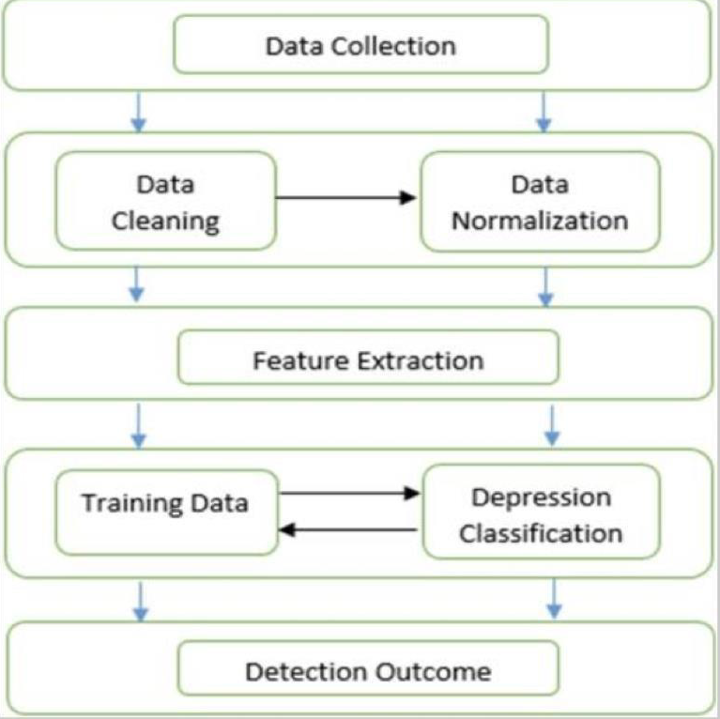
SYSTEM DESIGN
IMPLEMENTATION AND ANALYSIS
METHODOLOGY

Slide 5
IMPLEMENTATION-
1.Data Collection: Loading saved models ,The trained classification models are loaded from the pickle file, to be used for prediction on test dataset.
2. Data Preprocessing: The test dataset is preprocessed in a manner similar to the training data.
3. Class Prediction: Each search is classified into a depressed or neutral class.
4. Computation of Confusion Matrix: Based on the values of true or false positives and negatives we
compute the confusion matrix, for the evaluation of classification performance.
5. Backend consists of Machine Learning algorithms and AI models to detect/predict depression levels.
6.Chrome browsing of the user is monitored. It retrieves data based on google search results of the person. For this purpose, we are working with the browser history of the user.
7.The textual data retrieved from chrome is analyzed using NLP algorithms, and predictions are made on the same.
For evaluation formula used is:- F1 score= 2 * P*R/P+R
The results are evaluated on the basis of F1 score and accuracy. The F1 score is the primary performance
measure and accuracy is the secondary measure. F1 score is calculated based on the precision and recall.Here, P stands for Precision and R is the Recall.
TESTING-

Slide 6
Recall & Precision Formula
UI
The user interface is a chrome extension, i.e., a web-based UI
When the extension is enabled, it gives the depression levels of the person browsing on a scale of 1 to 10. A rating of 1 would indicate high levels of depression, while a rating of 10 will indicate low levels of depression.
This add-on additionally suggests measures and therapies to deal with depression. For example, depression relieving music, an appointment with a doctor or psychiatrist, etc.
There is also therapy chatbot or survey which helps to relieve depression and anxiety of the person. For now, it is just a simple chatbot created from Landbot.io. In the upcoming versions, we are planning to make it even more intelligent so as to tend to user needs as efficiently as possible.

Slide 7
OUTPUT
1.Monitor your Depression Levels
This depression detection browser extension helps in detecting the depression level of a person using
the browser by taking the browsing history and showing the level of depression in the range of 1 to 10. 1
means the worst level of depression and 10 means least depression.

Slide 8
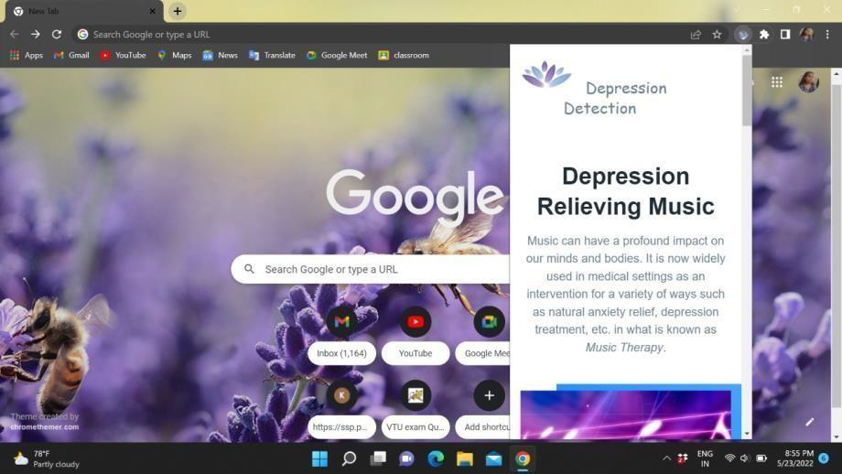
2.Suggests soothing music
Music therapy offers people a creative and accessible way of expressing their feelings and processing
their experiences. People have used music for its powerful effects on mood and emotions for a long
time. Aside from helping with mental health conditions, music therapy also has numerous other benefits,
such as providing a creative outlet, expanding knowledge and cultural awareness, and improving
cognitive skills such as memory.

Slide 9
3. Therapy ChatBots
Therapy bots are basically chatbots which can provide online therapy, using the rules of emotional
reasoning and Artificial Intelligence. But then, the inevitable question in everyone's mind is- “Is it
possible to automate the expertise needed to become an effective therapist?” Well, the responses in these
chatbots mainly comprises two elements. In some instances, the responses are based on Machine
Learning. In some, there’s a human element involved. When automation and human assistance work
together, the online therapy bot can nurture and assist patients in a better manner.

Slide 10
4.Suggests your nearest Psychiatrist
A psychiatrist is a medical physician who specializes in the care and treatment of mental, emotional,
and addictive disorders. A psychiatrist is involved in the prevention, diagnosis, and treatment of mental
diseases like anxiety, depression, psychosis, substance abuse, sexual dysfunction, and developmental
disabilities.

Slide 11
ADVANTAGES
This application can be used on any web browsers like google chrome etc.
It is very easy to install and user friendly application.
It is helpful to people where it detects the depression and suggests music, chatbot, psychiatrist accordingly.
It gives a precised value of the depression and the rating is given accordingly.
This application gives the early sign of depression where it helps the people from committing suicides, consuming pills, death etc.
Mental stability and positive thinking is developed among people.

Slide 12
CONCLUSION
We are developing a browser extension to detect depression at early stages using machine learning.
Proposed network can detect depression at early stages. The method can find applications in improving mental health issues faced by humans in everyday life. Also an approach to improve day to day life habits.
The following are the results obtained from this work : This system gives us a large amount of related
data for the analysis of depression symptoms extraction. We have used the browser history generated from
searches for the analysis. Then we calculated the scores and correlated it with symptoms. And later we will
give this data to the hospital which enables medical professionals to assess the state of the patient in a
better way. In summary, we studied three types of factors (emotional process, temporal process, linguistic
style) and trained a model to utilize each type of factor independently and jointly. We use machine learning
techniques to classify the features of comments. Our findings showed that all of the classifiers results are
almost between 60 and 80% .
Proposed system aims at reducing physical intervention of human beings in the process of detecting
depression in an individual. Previously, one had to look up to human doctors to identify depression
through standardized methods. On the other hand, our application automates this procedure, and quickly
provides us with a diagnostic report in private. The provided diagnostic comes with high accuracy, owing
to the large dataset on which model has been trained upon.

